Slide 1
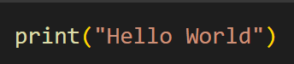

The Holy Grail of Python: the print() function.
print() takes in some input, and then outputs that input

Slide 2
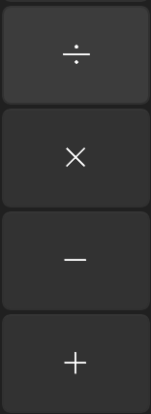
Doing math in Python is just like using a calculator.
In Python, you can easily:
Add +
Subtract -
Multiply *
Divide /
Exponent **
Modulo (get the remainder) %
You can use parentheses as well!

Slide 3
Doing basic logic in Python is just like doing basic math.
You can also use:
Greater than >
Less than <
Greater or equal >= (or less or equal <=)
Equals ==
Not equal !=
When you use these operators, you won’t get a number,
but instead a True or a False.

Slide 4
Recap
Recap of main points
The print() statement outputs whatever it is given.
You can do basic math in Python. (+, -, *, /, **, %)
You can do basic logic in Python. (>, <, >=, <=, ==, !=) - Logic returns a True or a False
Look at the notebook for some practice. Start at the top of the notebook and stop at Variables.

Slide 5
There a many different types of data: here are some of the most common ones.
Integer (int) - an integer - ex. 67
Float (float) - decimal number - ex. 34.234
Booleans (bool) - a True or a False - ex. True
String (str) - text - ex. “Strings need quotes, single quotes also work”

Slide 6
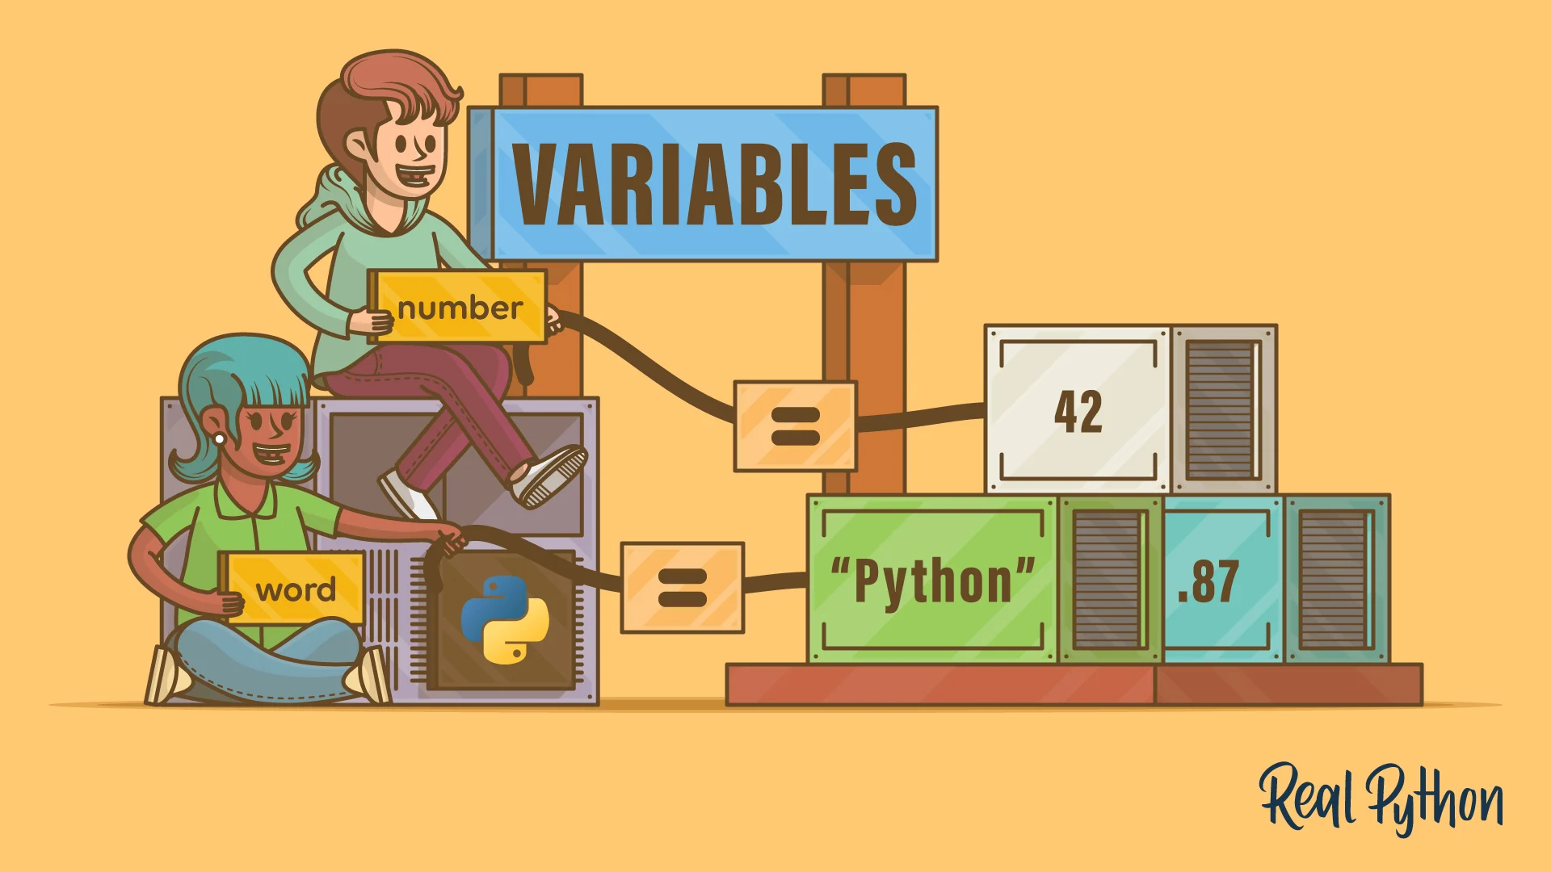
In Computer Science, variables are used to store information.
IMPORTANT: Name Your Variables Well
- If you need a variable for age, DON’T call it x or y, call it age.
From Real Python

Slide 7
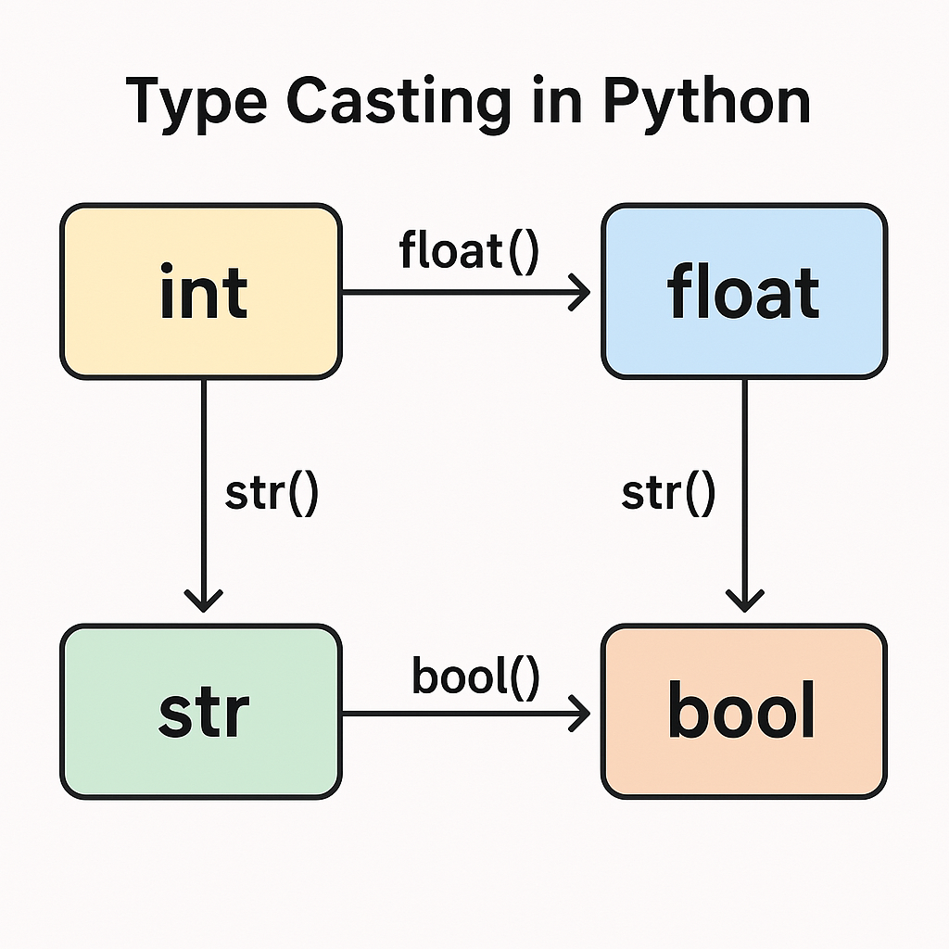
To convert between data types we can “cast” variables.

Slide 8
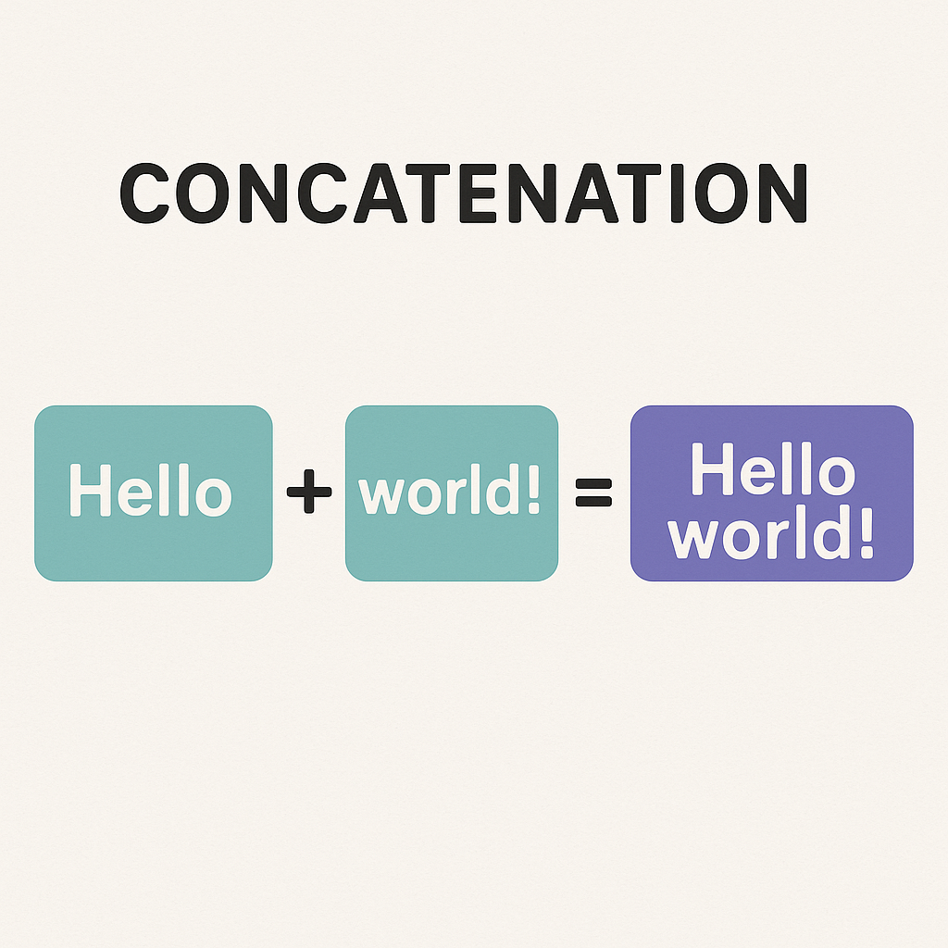
To combine strings we concatenate them.

Slide 9
Recap
There are different data types in Python (int, float, boolean, string, etc.)
Variables are used to store information of different data types. - IMPORTANT: Name your variables things that make sense
To convert between data types you can cast them.
To combine strings is called concatenating them.
Try it in the notebook! Start at Variables and end at Lists and Arrays.

Slide 10
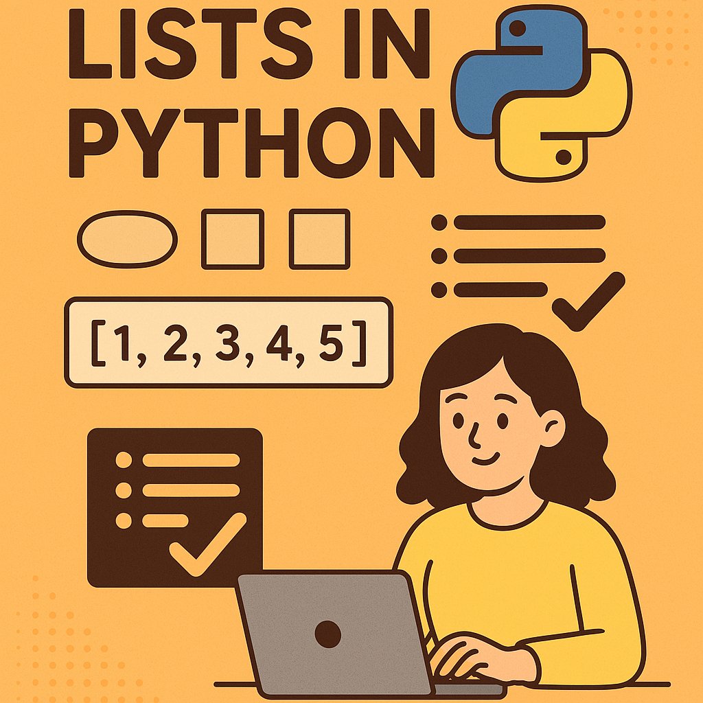
What is a List? Pretty Simple - A list of items

Slide 11
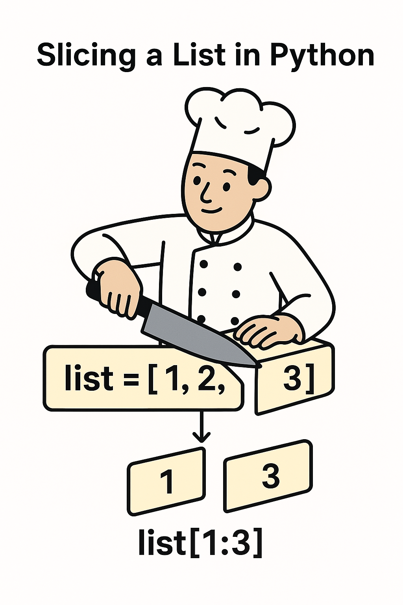
To access items in a list, we can use their indices.
Slicing
An index is the item’s position, except they start at zero instead of one.
Slicing is the process of getting a fraction of the whole list

Slide 12
There are many ways to change a list, here are a few:
Modifying
Adding
We can change specific elements in the list
We can add things to the list
Removing
Sorting
We can remove things from the list
We can sort the list

Slide 13
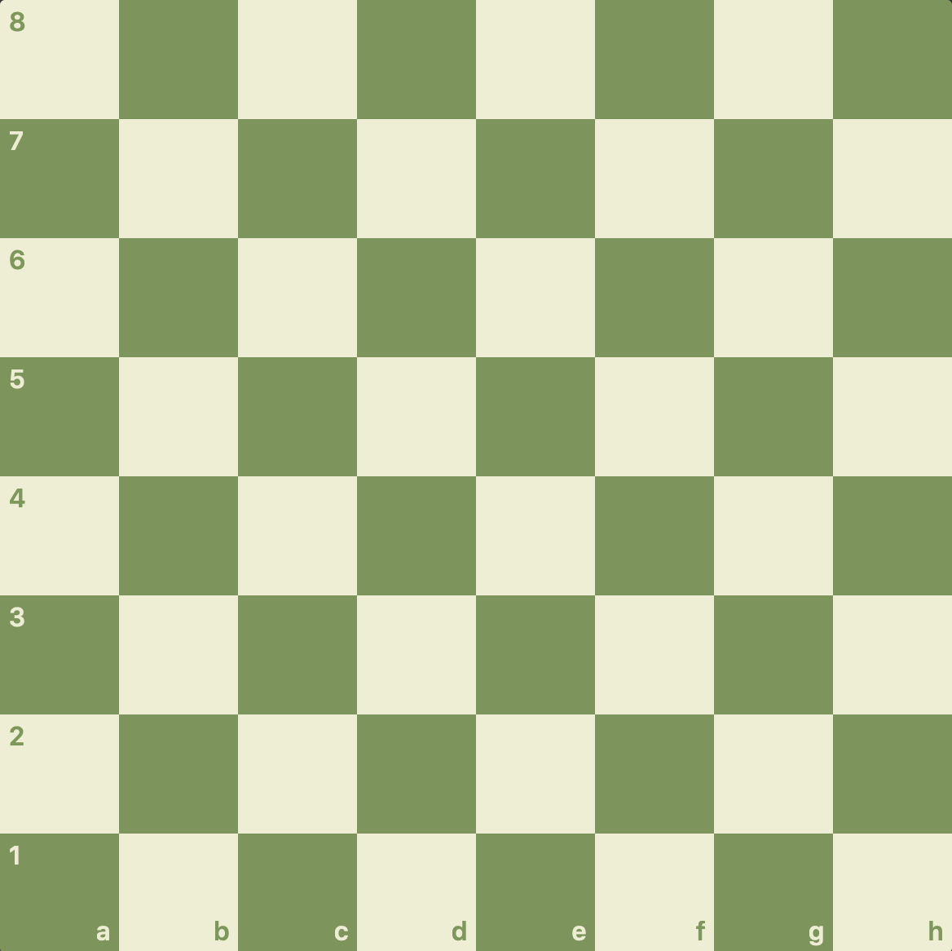
There are also 2D lists, which are just lists of lists.
You might use a 2D list to store the positions in a chessboard
From chess.com

Slide 14
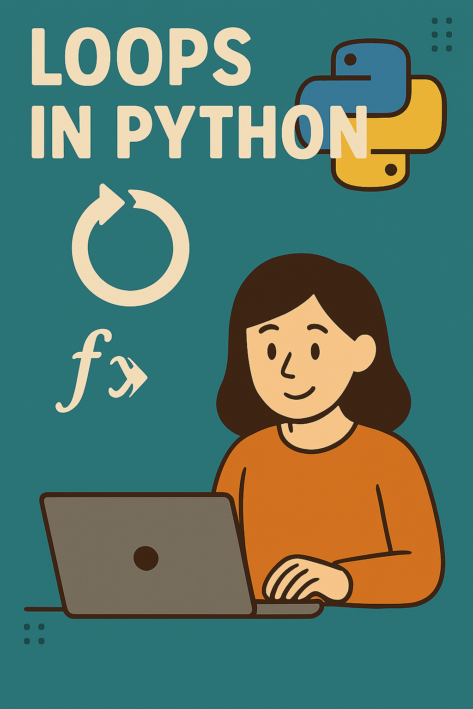
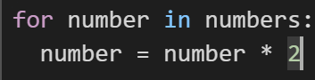
Loops loop through and run the same bit of code however many times are needed.

Slide 15
Recap
A List is an ordered collection of items. An array is a version of a list.
To access an element of a list we use the element’s index. The first element has an index of zero. We can also access sublists using a range of indices.
You can: modify an element in the list, add on to the list, remove from the list, and sort the list
To do one action repeatedly we use a loop. The for loop will run the same bit of code on each element of a specified list.
New Syntax: To tell Python that something is in the loop you put a colon after the loop, and then indent anything after the loop. - This type of syntax (called indentation) will appear throughout many parts of Python
Try it out in the notebook! Start at Lists and Arrays and stop at If…Then… (Conditionals).

Slide 16
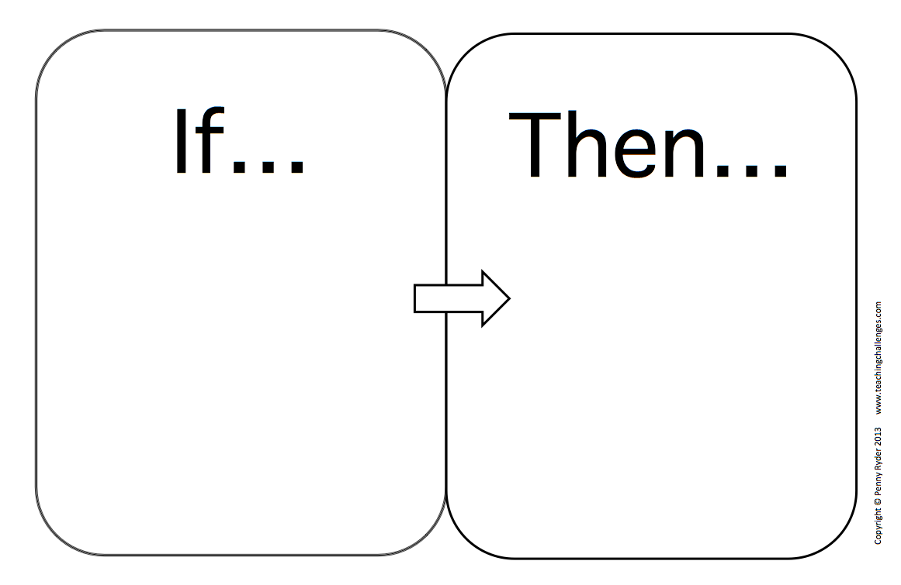
If… Then…
This stuff is true
Do this stuff
Something is true
Do this stuff

Slide 17
Booleans can also use their own operators:
not - flips a True to a False or a False to a True
and - returns true only if both elements are true
or - returns true if at least one of the elements are true
Equals == - returns true if both elements are the same.
Not equals != - returns true if both elements are different

Slide 18
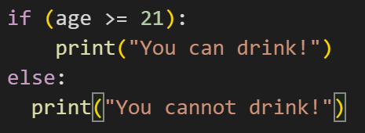
If we have talked about Booleans: Then continue talking about conditionals
More complex if statements: if they have enough money and their credit is good then…
Else statements: run if the if statement fails
Else if (elif) statements: run if the if statement fails and check their own condition

Slide 19
Recap
If…Then… statements are called Conditionals. They will only run the then… code if the if… condition is satisfied. The if condition must return a boolean.
Booleans are either a True or a False. They have their own set of operators: not, and, or, ==, !=.
You can use boolean operators to have more complex if statements.
There are also else and else if (elif) statements. Else statements will run if the if statement fails. Elif statements will run if the if statement fails, but they will also check their own condition.
Try it in the notebook. Start at If…Then… (Conditionals) and stop at Functions.

Slide 20
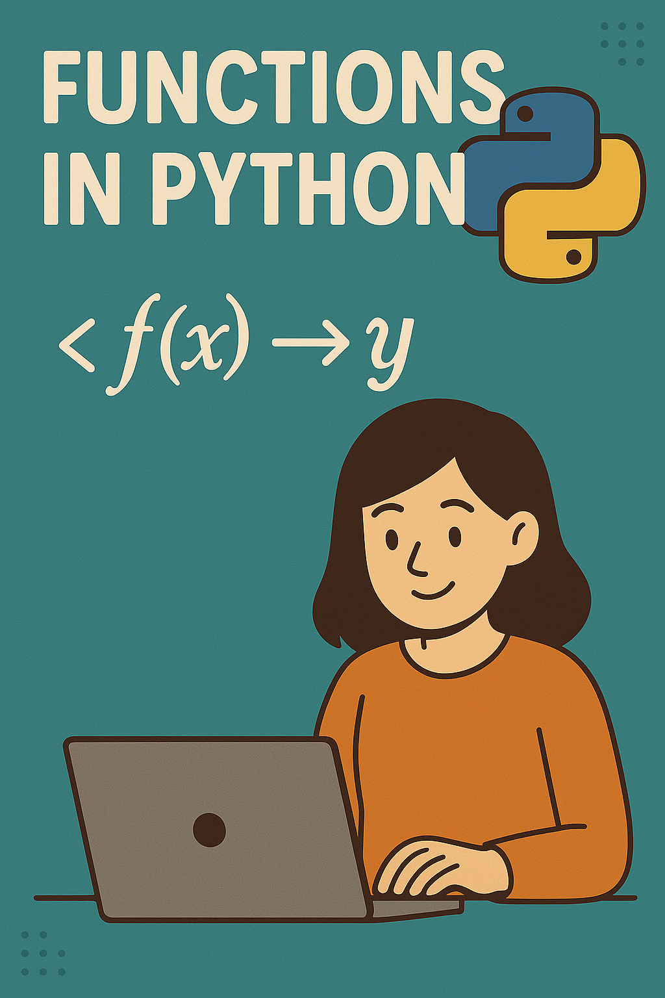
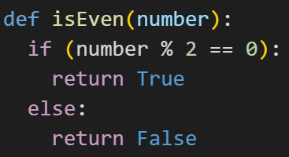
Functions make doing complicated actions multiple times way easier.

Slide 21
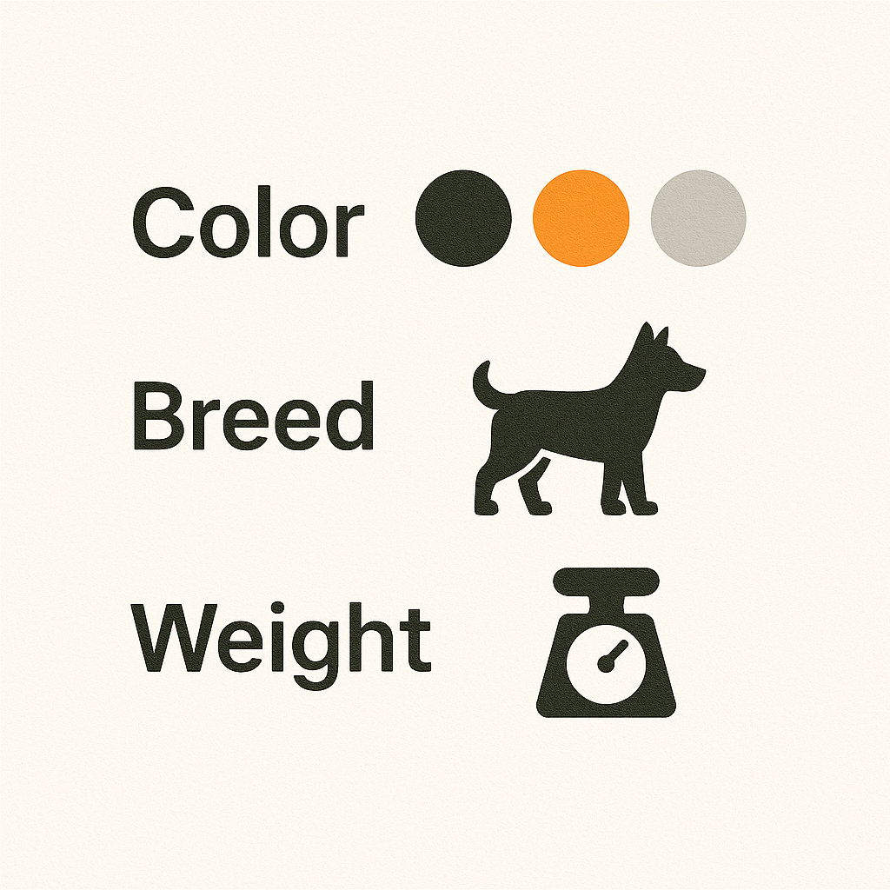

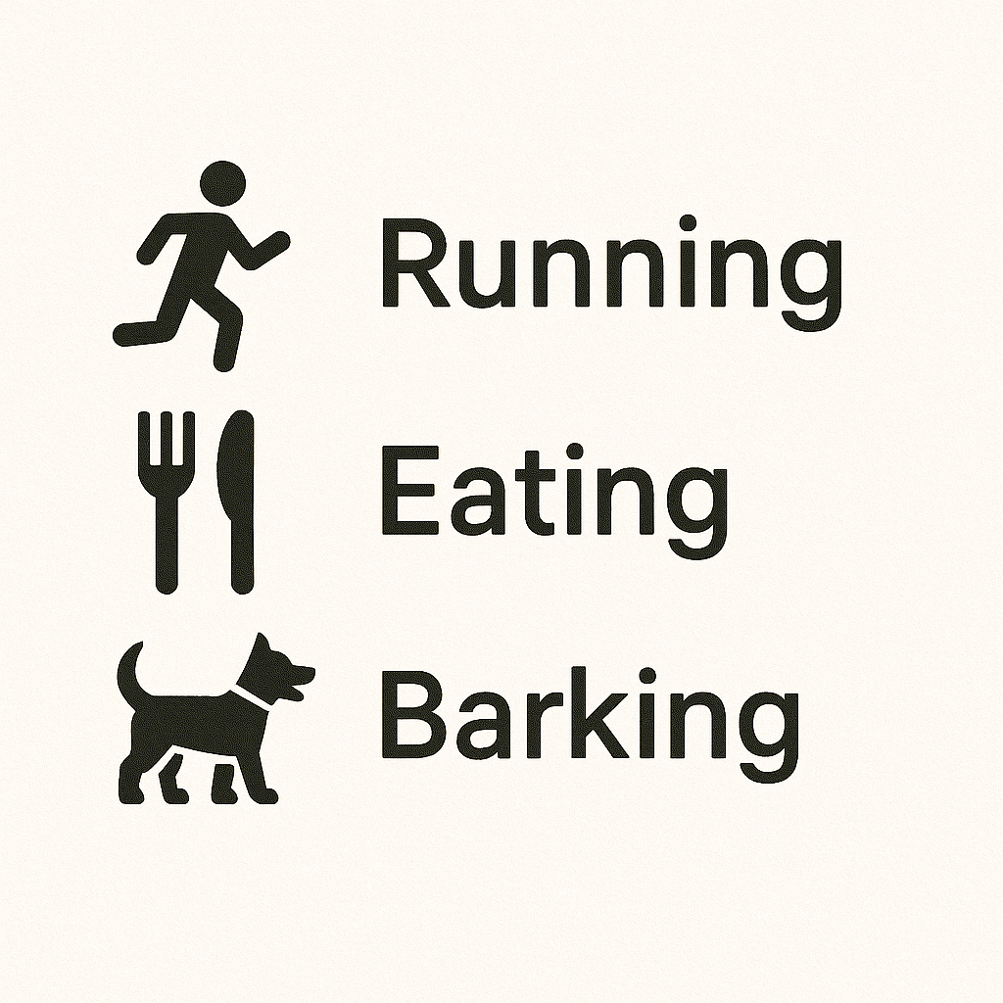
A class is a collection of variables and functions.
Example: We might have a Dog class.
This class could have the variables color, breed, weight
And might have the functions run(), eat(), and bark().

Slide 22
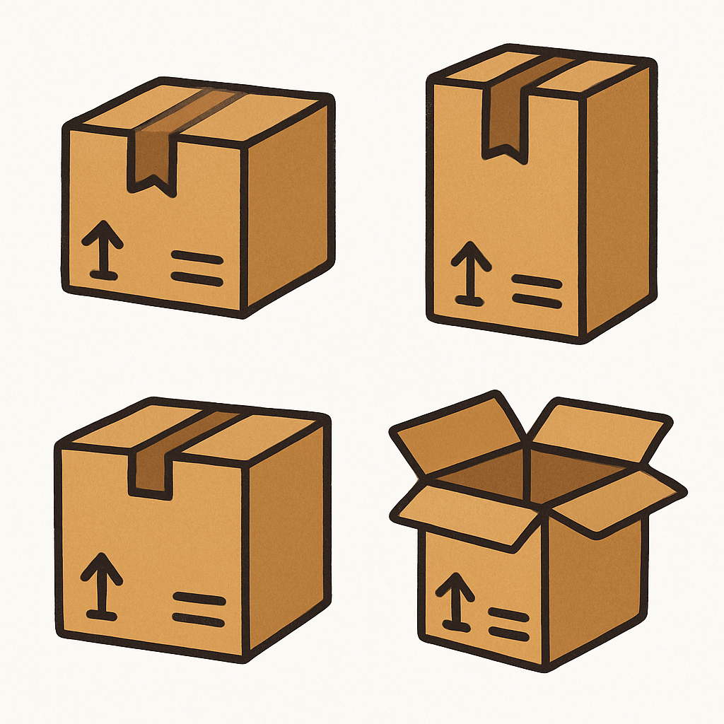
Packages are useful functions and classes that have been created by other people that are free for us to use.

Slide 23
Recap
In Python, functions are used similarly to loops: they make doing the same action over and over again easier.
Functions don’t have to take in inputs, but when they do, they are called parameters or arguments.
A class is a collection of variables and functions. Classes are used similarly to functions, it makes creating the same type of thing over and over again way easier.
A package is a collection of classes and function made by other people.
Try it out in the notebook. Start at functions and stop at Mini Projects.

Slide 24
Fibonacci Project
Write a function that takes in a number and returns its fibonacci number.
As a reminder, the fibonacci sequence is one where each number is the last two added together:
1, 1, 2, 3, 5, 8, 13, 21, 34, 55, …
So, if I give this function the number 6, it should return the number 8

Slide 25
If you need a refresher or want to learn more, visit this site: https://www.w3schools.com/python/

Slide 26
Break

Slide 27
Mini-Projects
How to Tackle Coding Problems:
Write Pseudocode
Pseudocode is the outline of what the code should look like.
When trying to solve a coding problem, write the pseudocode first in as much detail as you can.
Example of pseudocode: if they are older than 21, then they can drink
- this obviously won’t run if I copy paste it into Python. But it is the basic outline of what I need to do.
Then try and code the parts of the pseudocode.
In the notebook there are a few mini projects, we are going to spend the next bit of time working on those.

Slide 28

Intro to Vectors
From Despicable Me

Slide 29
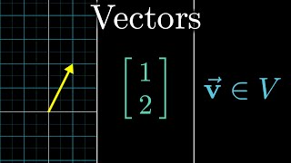
From 3Blue1Brown

Slide 30
Homework

